Slide 1
Assignment 2
TYPES OF GRAPHS, PLOTS, CHARTS AND DISTRIBUTIONS WITH USAGE AND IMAGE.

Slide 2
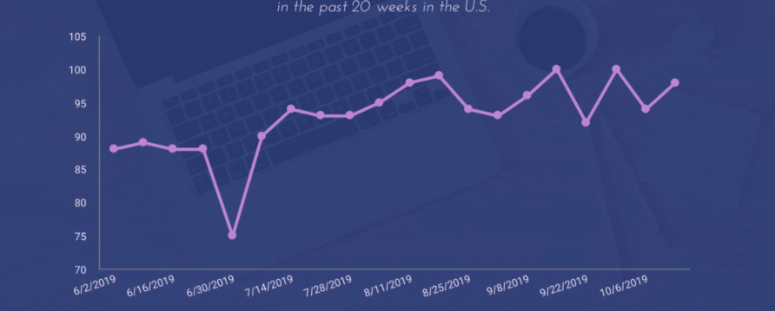
Types of graphs and uses
Graphs are used to visualize data.
1. A line graph is commonly used to display change over time as a series of data points connected by straight line segments on two axes. The line graph therefore helps to determine the relationship between two sets of values, with one data set always being dependent on the other set. Line graphs are drawn so that the independent data are on the horizontal a-axis (e.g. time) and the dependent data are on the vertical y-axis. Line graphs are used to track changes over short and long periods of time.

Slide 3
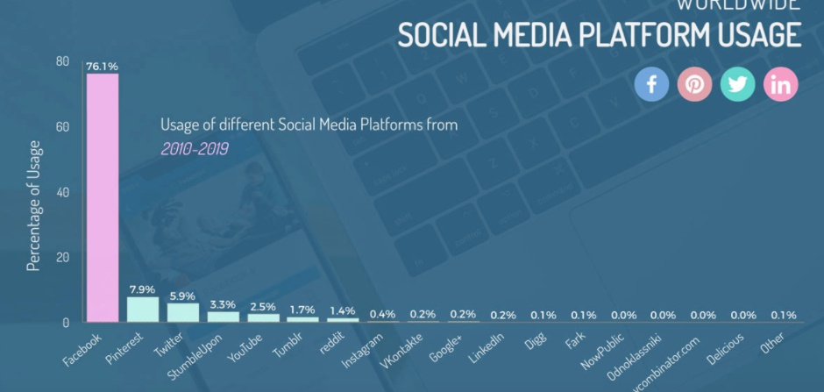
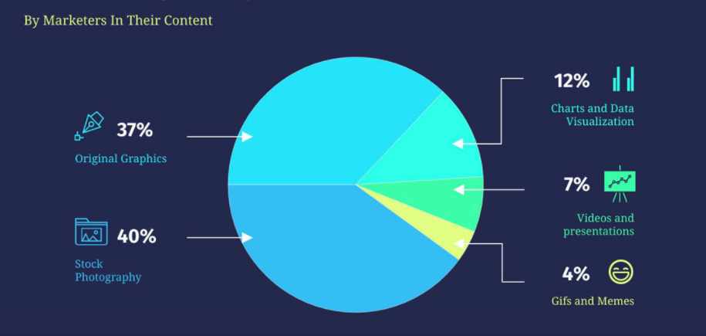
2. Bar charts are often primarily used for displaying the quantities of qualitative or categorical data (e.g. age group, religious affiliation), although they can also be used for quantitative data if the number of unique scores in the data set is not large. Bar charts can be displayed horizontally or vertically.
3. A pie chart is a divided circle, in which each slice of the pie represents a part of the whole. The categories that each slice represents are mutually exclusive and exhaustive. Data with negative values cannot be displayed as a pie chart. Pie charts can provide a quick overall impression of a data set, but do not offer very detailed information. Additional information can be added into pie charts by inserting figures (e.g., percentages) into each segment of the chart, or by providing a separate table as a reference tool.

Slide 4
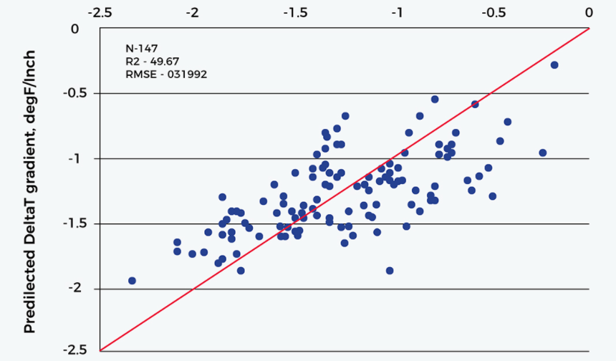
4. A Scatterplot is used to display the relationship between two quantitative variables plotted along two axes. A series of dots represent the position of observations from the data set. The independent variable is generally plotted along the horizontal (X) axis, and the dependent (or responsive) variable along the vertical (Y) axis. If no dependent variable exists, either type of variable can be plotted on either axis; in this case, the scatter plot will illustrate only the degree of correlation (and not causation) between two variables. Usually scatterplots have a single line (called a regression line) running through them. The line of the scatterplot represents the trend of the relationship between the two variables, Scatterplots are used to analyse patterns of the relationship between two sets of continuous data. Scatterplots can visually show the strength of the relationship between the variables (i.e., the “scatter” in the plot: the more concentrated the dots are along the line, the stronger the relationship); whether there is a positive or negative association between the variables (i.e., whether the slope is positive or negative); whether the data pattern is linear (straight) or nonlinear (curved); and whether unusual features such as outliers, clusters and gaps exist in the data sets.

Slide 5
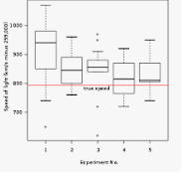
5. A boxplot is a standardized way of displaying the distribution of data based on a five number summary (“minimum”, first quartile (Q1), median, third quartile (Q3), and “maximum”). It can tell you about your outliers and what their values are. It can also tell you if your data is symmetrical, how tightly your data is grouped, and if and how your data is skewed.
median (Q2/50th Percentile): the middle value of the dataset.
first quartile (Q1/25th Percentile): the middle number between the smallest number (not the “minimum”) and the median of the dataset.
third quartile (Q3/75th Percentile): the middle value between the median and the highest value (not the “maximum”) of the dataset.
interquartile range (IQR): 25th to the 75th percentile.

Slide 6
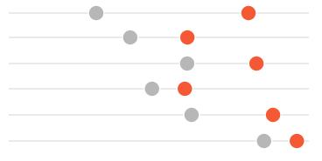
Dot plots encode single data points with circles, often on a line. While a bar on a bar chart consumes a lot of space in order to represent a single number, a dot in a dot plot simply represents the single number. Comparisons are easily made by plotting more than one dot per line, such as pretest scores and posttest scores. According to prominent data visualization scholars, dots on a line is the easiest graph type for people to interpret. Dot plots are handy for comparing between 2-4 points on a line. If you have more than 4 points, the dot plot will likely get too cluttered. If you have points that are very close together, the dots will overlap one another and could be difficult to interpret unless you forego direct number labeling and make each dot empty or transparent.

Slide 7
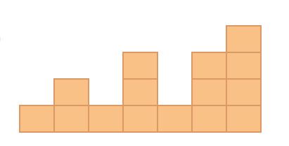
A histogram is a graphical way of presenting a frequency distribution of quantitative data organized into a number equally spaced intervals or bins (e.g. 1-10, 11-20…). The interval range is selected to reduce the amount of information while still providing enough variability to picture the shape of the distribution. The intervals are displayed on one axis (often the x-axis), against which are plotted the frequency of a particular piece of data which falls within that interval (often on the y-axis). Histograms can also be constructed by plotting relative frequencies, percentages, or proportions on the y-axis.

Slide 8
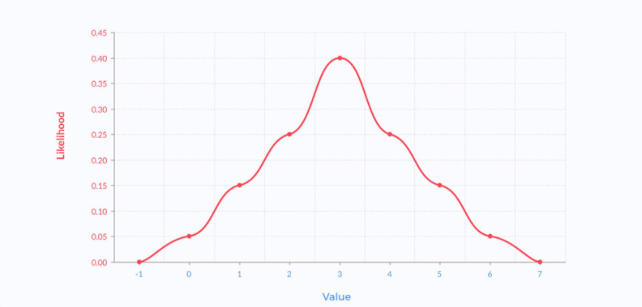
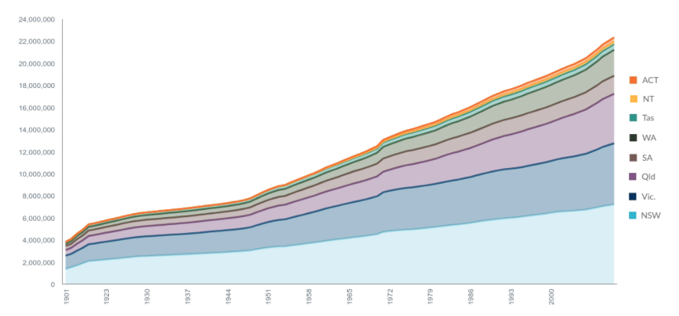
6. Function plots: it's used to determine the value of an equation by graphing its result.
7. Stacked area charts: it's frequently used to diagram changes of multiple variables across time.

Slide 9
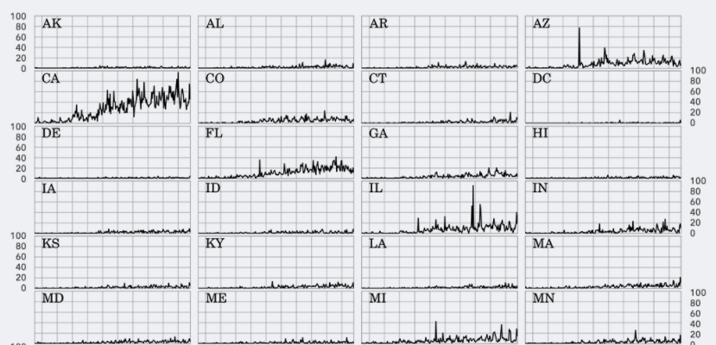
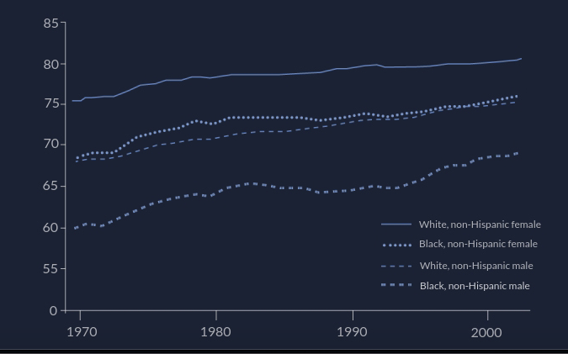
8. Trellis graphs: To examine complex, multi-variable data sets, comparing a greater deal of information at once.
9. Multi-Line Graphs: To reflect multiple data sets with lines of varying patterns or color.

Slide 10
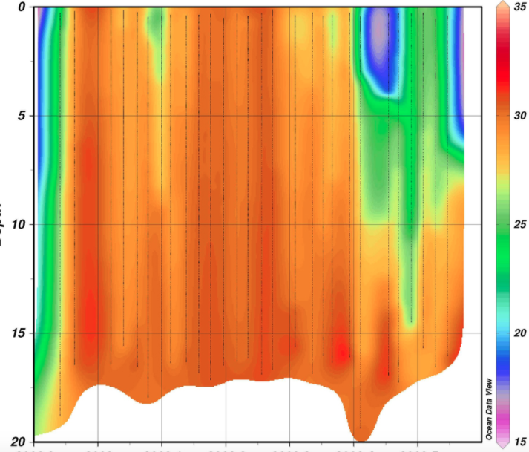
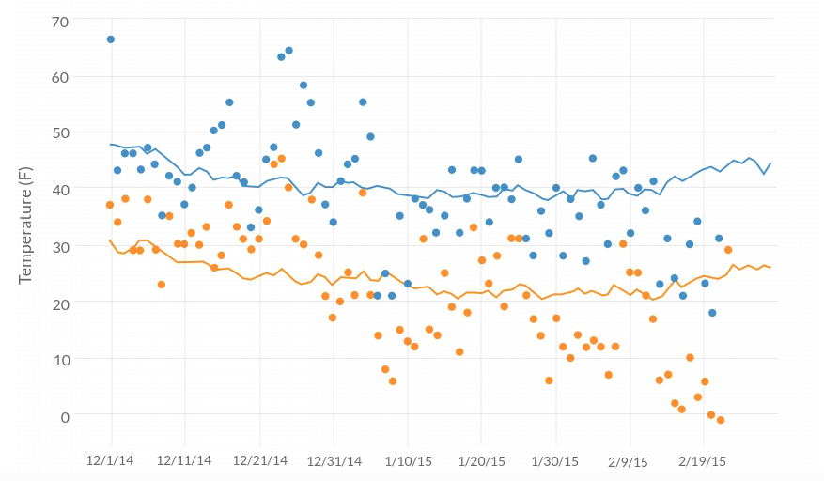
10. Contour plot: allow for the analysis of three variables in a two-dimensional format with a third value in color.
11. Scatter-Line Combo: A combination of the scatterplot and line graph.

Slide 11
Different graphs in R
HISTOGRAM: A histogram is a graphical tool that works on a single variable.
CODE: hist(trees$Height, breaks = 10, col = "orange", main = "Histogram of Tree heights", xlab = "Height Bin").
SCATTER PLOT: This plot is a simple chart type, but a very crucial one having tremendous significance. The chart gives the idea about a correlation amongst variables and is a handy tool in an exploratory analysis.
CODE: attach(trees) plot(Girth, Height, main = "Scatterplot of Girth vs Height", xlab = "Tree Girth", ylab = "Tree Height") abline(lm(Height ~ Girth), col = "blue", lwd = 2).

Slide 12
BOXPLOT: is a way of visualizing data through boxes and whiskers. Firstly, variable values are sorted in ascending order and then the data is divided into quarters.
CODE: boxplot(trees, col = c("yellow", "red", "cyan"), main = "Boxplot for trees dataset").
LINE CHARTS: are useful when comparing multiple variables.
CODE: plot(Girth, type = "o", col = "red", ylab = "", ylim = c(0, 110), + main = "Comparison amongst Girth, Height, and Volume of trees") lines(Height, type = "o", col = "blue") lines(Volume, type = "o", col = "green") legend(1, 110, legend = c("Girth", "Height", "Volume"), + col = c("red", "blue", "green"), lty = 1:1, cex = 0.9)
DOT PLOT: This visualization tool is useful if we want to compare multiple categories against a certain measure.
CODE: attach(mtcars) dotchart(disp, labels = row.names(mtcars), cex = 0.75, + main = "Displacement for various Car Models", xlab = "Displacement in Cubic Inches")

Slide 13
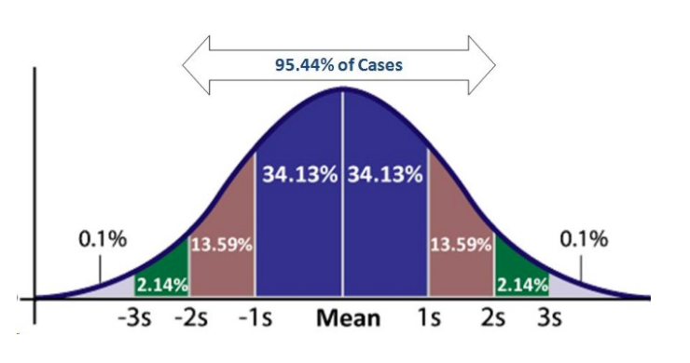
Probability Distribution
A probability distribution tells you what the probability of an event happening is. Probability distributions can show simple events, like tossing a coin or picking a card. They can also show much more complex events, like the probability of a certain drug successfully treating cancer. Probability distributions describe the dispersion of the values of a random variable. Consequently, the kind of variable determines the type of probability distribution.

Slide 14
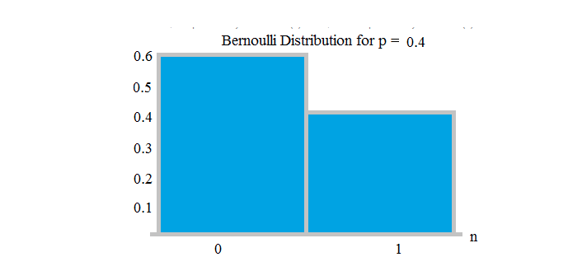
Bernoulli Distribution
The simplest distribution is Bernoulli Distribution. It has only two possible outcome, either 1 (success) or 0 (failure), and a trial. Let X be the random variable of having fight between A and B that takes 1 as the probability of winning of A as success (p) and 0 as the probability of losing of A as failure (1-p or q). - Probability of success = 0.4 - Probability of gailure= 0.6

Slide 15
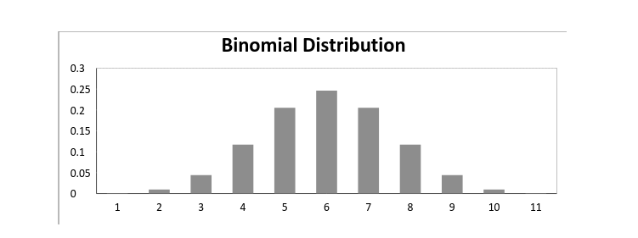
BINOMIAL DISTRIBUTION
A binomial distribution can be thought of as simply the probability of a SUCCESS or FAILURE outcome in an experiment or survey that is repeated multiple times. For example, a coin toss has only two possible outcomes: heads or tails and taking a test could have two possible outcomes: pass or fail.

Slide 16
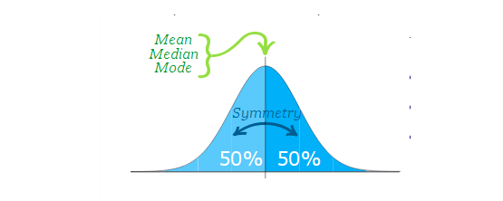
NORMAL DISTRIBUTION
Sometimes called the bell curve, is a distribution that occurs naturally in many situations.
The bell curve is symmetrical. Half of the data will fall to the left of the mean; half will fall to the right. Many groups follow this type of pattern:
Heights of people.
Measurement errors.
Blood pressure.
Points on a test.
IQ scores.
Salaries.

Slide 17
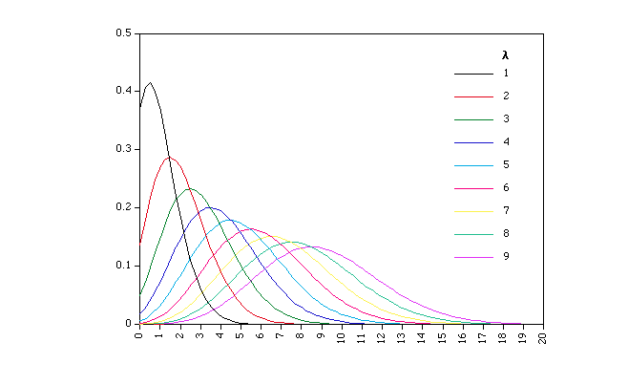
Poisson Distribution
The distribution in which one successful event does not influence other successful event and the probability of success of short interval is equal to probability of success of longer interval is called Poisson Distribution. The probability of success in an interval approaches zero as the interval becomes smaller.

Slide 18
Non-normal distributions
Although the normal distribution takes center stage in statistics, many processes follow a non-normal distribution. This can be due to the data naturally following a specific type of non-normal distribution (for example, bacteria growth naturally follows an exponential distribution). In other cases, your data collection methods or other methodologies may be at fault.

